Slide 1
Modeling Airbnb NYC listing price Final presentation
By: Muluemebet Ayalew
April ,2020
http://datascienceandme.com/

Slide 2
Outline
Situation
Task
Analysis
Result

Slide 3
Situation
Data : The New York city Airbnb open data. The data contains information about host, location, room type, price, review and availability. The data contains roughly 50,000 rows and 16 columns.
Data Source: Inside Airbnb, an online marketplace for booking and/or listing lodging, homestay or tourist houses. And other publicly available geographic data.
Goal : make a model that can predict the price of a new listing.

Slide 4
Task
The task is to make a better model that can estimate the listing price.
Methodology:
Steps:
data exploration
Data cleaning, feature engineering
Statistical testing
Modeling and diagnosis
Model selection
Tools : python packages(numpy, pandas, matplotlib, seaborn, sklearn, statsmodels)

Slide 5
Analysis
Exploratory data Analysis
Statistical analysis
Modeling

Slide 6
Data Cleaning and preparation
Missing data :
reviews per month was filled by zero, inferred from the variable ‘number of review’, it has zero review at first place.
The other three was not included in the model(thought not relevant)
Outliers : price above mean plus three standard deviation are ignored (treated as outliers)
Bad entry : zero price doesn’t make sense(removed)
Variable Name | Number of missing values
name | 17
host_name | 563
last_review | 10220
reviews_per_month | 10220

Slide 7
Feature Engineering
Craft new features:
distance from subway station,
distance from subway entrance,
distance from Penn station,
distance from Time Square,
is_hotel
Feature encoding:
dummy variable for neighborhood group and room type
Target encoding for neighborhood

Slide 8
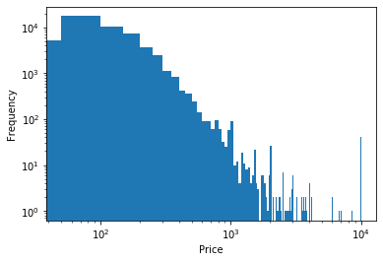
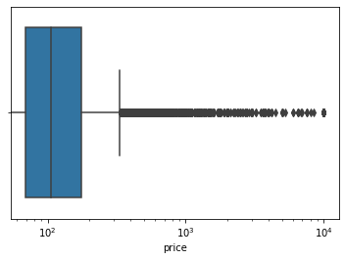
Exploratory Data Analysis
Price distribution:
The distribution is skewed to the right
large data to display

Slide 9
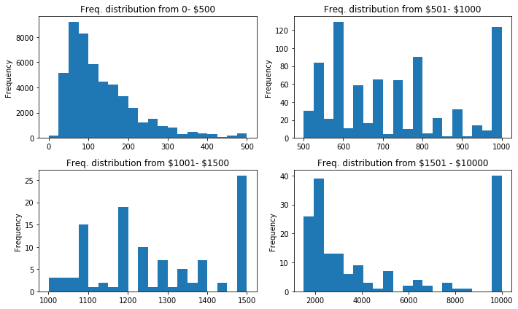
Price distribution for different price range
Better display with smaller data

Slide 10
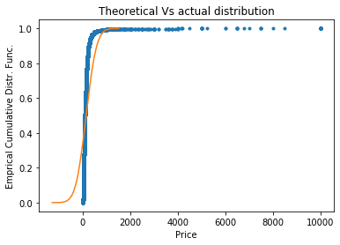
Empirical cumulative Distribution Function
This is how the original data looks

Slide 11
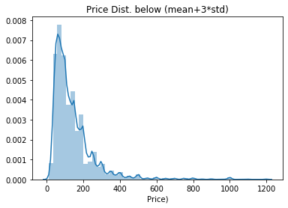
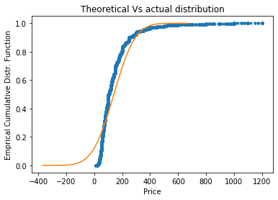
After removing outliers above (mean+3*std)

Slide 12
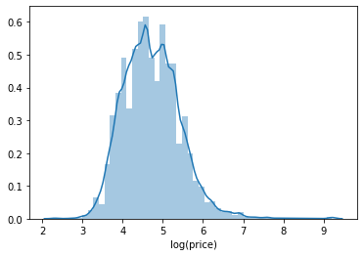
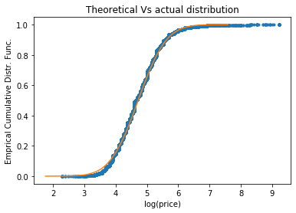
Distribution after log transformation of price

Slide 13
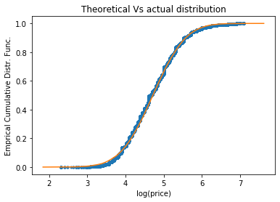
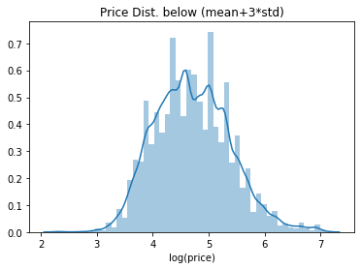
Combining the last two: Prices below (mean+ 3 *std) and log transformed

Slide 14
Cont..
The original listing price is highly skewed to the right and difficult to assume normal distribution.
After log transformation, it looks normally distributed
Removing outlier and log transformation even make the price distribution looks normal

Slide 15
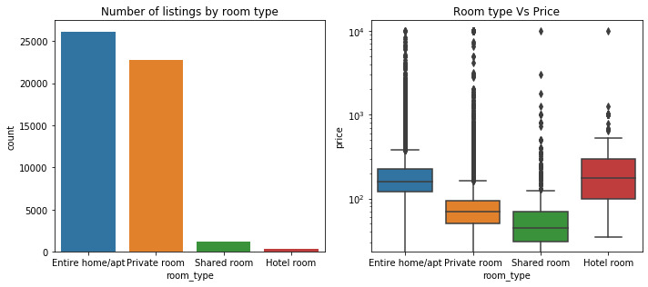
Exploratory Data Analysis of Predictor Variables
Room type: Entire home apartment is the most expensive than others

Slide 16
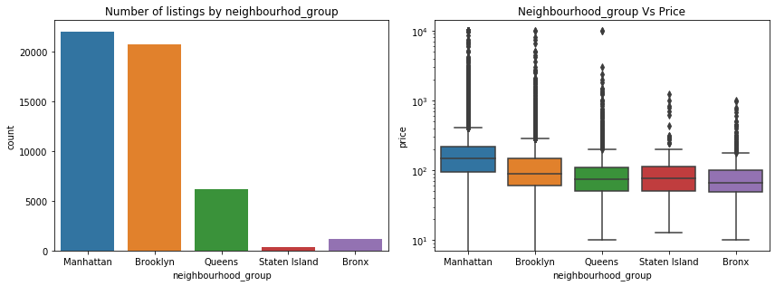
Exploratory Data Analysis of Predictor Variables
Neighborhood Group: Manhattan is the most expensive, Brooklyn is the second most expensive. Both Manhattan and Brooklyn account more than 84 % of the listings in New York City.

Slide 17
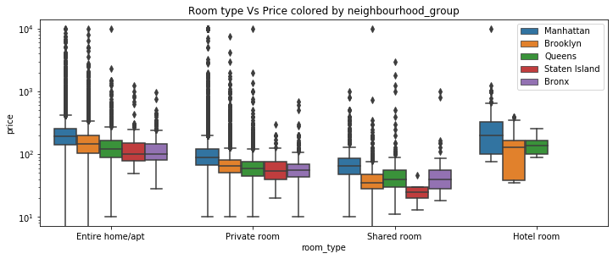
Price by Room type and neighborhood group

Slide 18
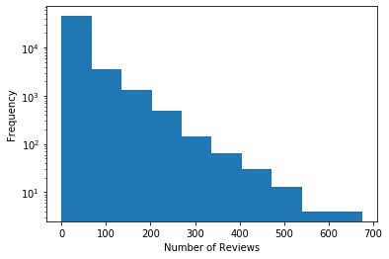
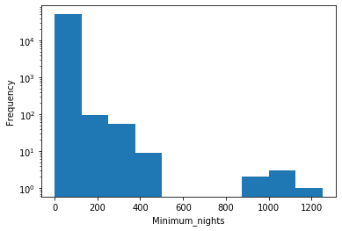
Exploratory Data Analysis
Minimum night and number of reviews
Distribution of number of reviews
Distribution of minimum nights requested by hosts

Slide 19
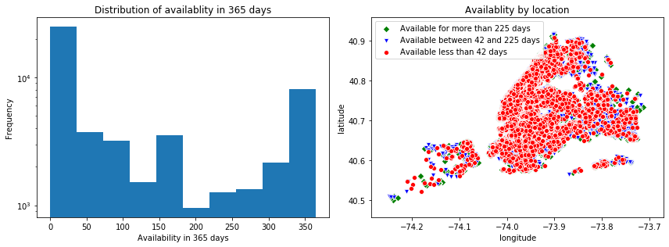
Cont.
Availability 365 days

Slide 20
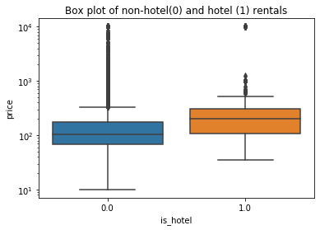
Statistical analysis
The null hypothesis: The mean price of hotel and non-hotel listings are the same in New York city.
Alternative hypothesis: The mean price of hotel is greater than the mean price of non-hotel listing in New York city(one-tailed)

Slide 21
Test statistics
significance level was set (0.05)
t-test statistics with the same variance
Same variance is again tested using the hypothesis:
H0: The standard deviations of listing price for hotel and non-hotel are the same.
H1: The standard deviation of listing price for hotel and non-hotel is the same (two tailed).
Bootstrapped test resulted p-value of 0.4736 which is greater than the significance level (0.05). The null hypothesis that the two groups have the same variance(standard deviation) accepted.

Slide 22
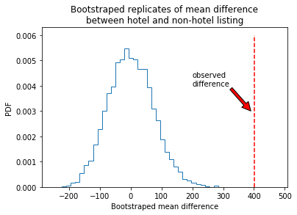
Test statistics
t-value =26.808
With 5% significance level and one tailed test we can get the t-score of 1.6449 . The calculated t-value(26.808) is very large and the probability to get t-scores above this point is very small.
Therefore, the difference in mean price between hotel and non-hotel listing is statistically significant.
The same result is obtained using bootstrapped test.

Slide 23
Modeling
The following methods were used to model the listing price:
linear regression
lasso regression
K-nearest neighbors (Knn)
decision tree
random forest and
cat-boost

Slide 24
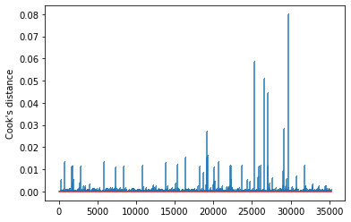
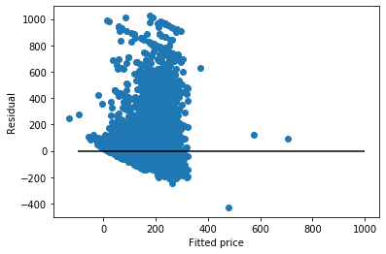
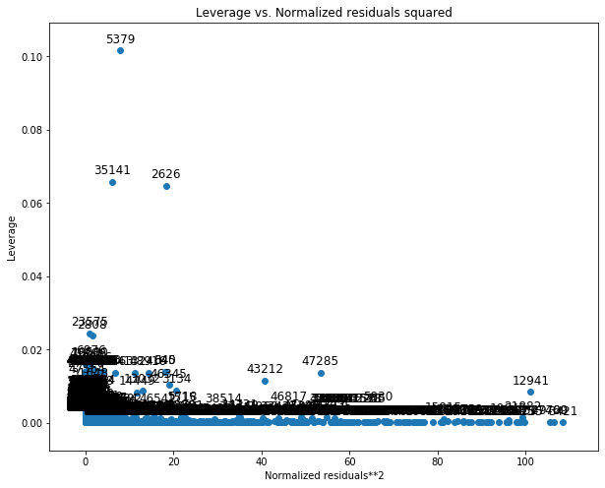
Regression diagnosis
Influential points
Leveraging point
Linearity and constant variance

Slide 25
Regression model after corrective measures
 | coef | std err | t | P>|t| | [0.025 | 0.975]
Intercept | 4.6242 | 0.014 | 327.907 | 0.000 | 4.597 | 4.652
neighb_encoded | 0.0038 | 8.06e-05 | 46.862 | 0.000 | 0.004 | 0.004
minimum_nights | -0.0027 | 0.000 | -23.988 | 0.000 | -0.003 | -0.003
number_of_reviews | -0.0002 | 4.38e-05 | -4.729 | 0.000 | -0.000 | -0.000
calculated_host_listings_count | -0.0005 | 6.62e-05 | -7.139 | 0.000 | -0.001 | -0.000
availability_365 | 0.0004 | 1.65e-05 | 25.651 | 0.000 | 0.000 | 0.000
is_hotel | 0.5650 | 0.047 | 12.068 | 0.000 | 0.473 | 0.657
dist_nearest_SubwayEntrance | 0.0184 | 0.004 | 4.419 | 0.000 | 0.010 | 0.027
dist_from_PennStation | -0.0163 | 0.001 | -21.283 | 0.000 | -0.018 | -0.015
neighbourhood_group_Brooklyn | 0.0242 | 0.007 | 3.630 | 0.000 | 0.011 | 0.037
neighbourhood_group_Manhattan | 0.0528 | 0.008 | 6.400 | 0.000 | 0.037 | 0.069
room_type_Hotel_room | -0.8566 | 0.052 | -16.438 | 0.000 | -0.959 | -0.754
room_type_Private_room | -0.6762 | 0.004 | -154.333 | 0.000 | -0.685 | -0.668
room_type_Shared_room | -1.0879 | 0.013 | -81.317 | 0.000 | -1.114 | -1.062
log transformation of price (outcome variable),
removal of outliers and leveraging points and
removal of non-significant variables (with p-value above 0.05)

Slide 26
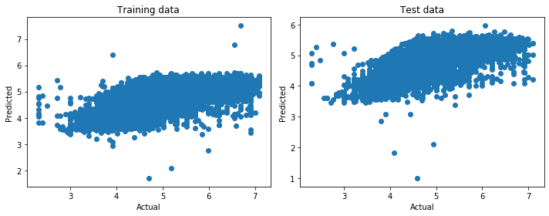
Regression performance
Dep. Variable: | np.log(price) | R-squared: | 0.610
Model: | OLS | Adj. R-squared: | 0.610
Method: | Least Squares | F-statistic: | 4091.
Date: | Fri, 24 Apr 2020 | Prob (F-statistic): | 0.00
Time: | 13:00:29 | Log-Likelihood: | -15198.
No. Observations: | 34045 | AIC: | 3.042e+04
Df Residuals: | 34031 | BIC: | 3.054e+04
Df Model: | 13
Covariance Type: | nonrobust

Slide 27
Model performance summary
 | Performance of training data |  |  | Performance of test data
Model | r2 | mean_abs_error | mean_sqr_error | r2 | mean_abs_error | mean_sqr_error
linear_regresion | 0.32 | 55.14 | 9671.90 | 0.32 | 56.11 | 9970.00
Linear_corrected | 0.61 | 0.29 | 0.14 | 0.55 | 0.33 | 0.20
lasso | 0.32 | 55.09 | 9673.14 | 0.32 | 56.04 | 9974.09
Knn | 0.53 | 0.38 | 0.47 | 0.33 | 0.45 | 0.66
Decision_tree | 0.38 | 52.23 | 8851.71 | 0.35 | 54.04 | 9596.65
Random_forest | 0.55 | 45.74 | 6451.13 | 0.41 | 51.33 | 8665.17
Catboost | 0.45 | 50.09 | 7915.46 | 0.41 | 52.01 | 8717.86

Slide 28
Summary
The linear regression model after corrective measures (log transformation of price, removal of leveraging points and outliers, and removal of non- significant variable) perform better than other models.
Further analysis can be done by combining unsupervised and supervised learning methods. For example clustering and then regression.

Slide 29
Reference
2020, “What is Airbnb and how does it work?” Airbnb. Accessed Jan 30, 2020. https://www.airbnb.com/help/article/2503/what-is-airbnb-and-how-does-it-work
Dec, 2019, “Get The Data”, Inside Airbnb, Accessed Jan 30, 2020. http://insideairbnb.com/get-the-data.html

